Slide 1
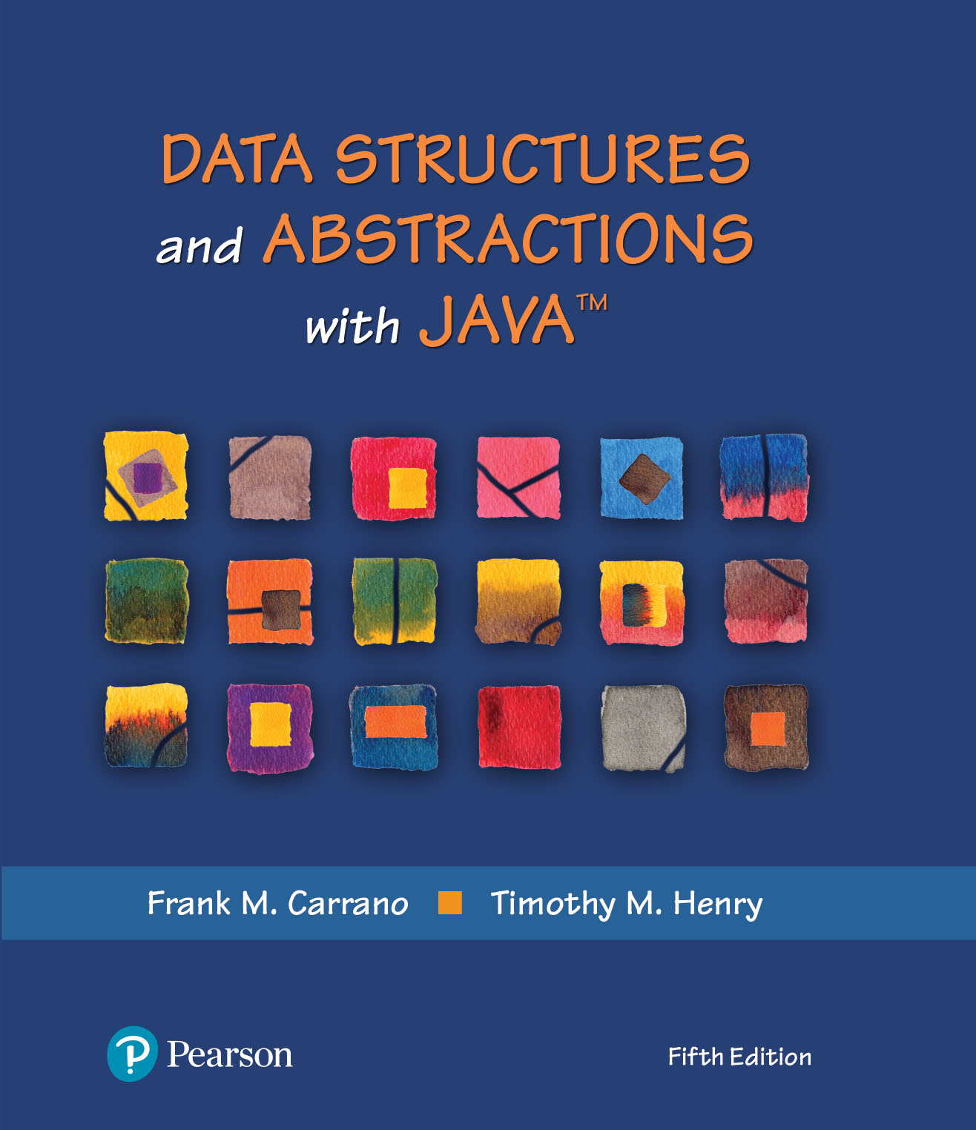
Module 9 - Recursion
Recursion & Problem Solving with Recursion (Ch. 9 & 14)

Slide 2
Video Notes
Introducing Recursion
https://mediaplayer.pearsoncmg.com/assets/secs-vn-ch09a-introducing-recursions
Using Recursion
https://mediaplayer.pearsoncmg.com/assets/secs-vn-ch09b-using-recursion
Notes:
To maximize your learning experience, prepare for class prior each week

Slide 3
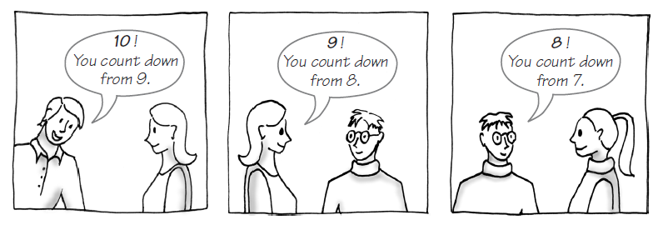
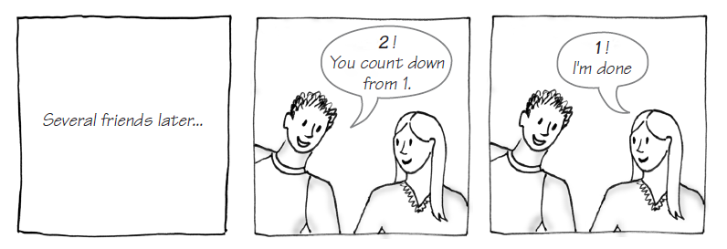
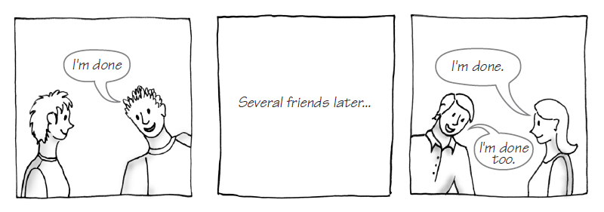
The Countdown
Notes:
Perform your task, say “10”
Repeat again with a smaller number “9”
Loop vs. recursion

Slide 4
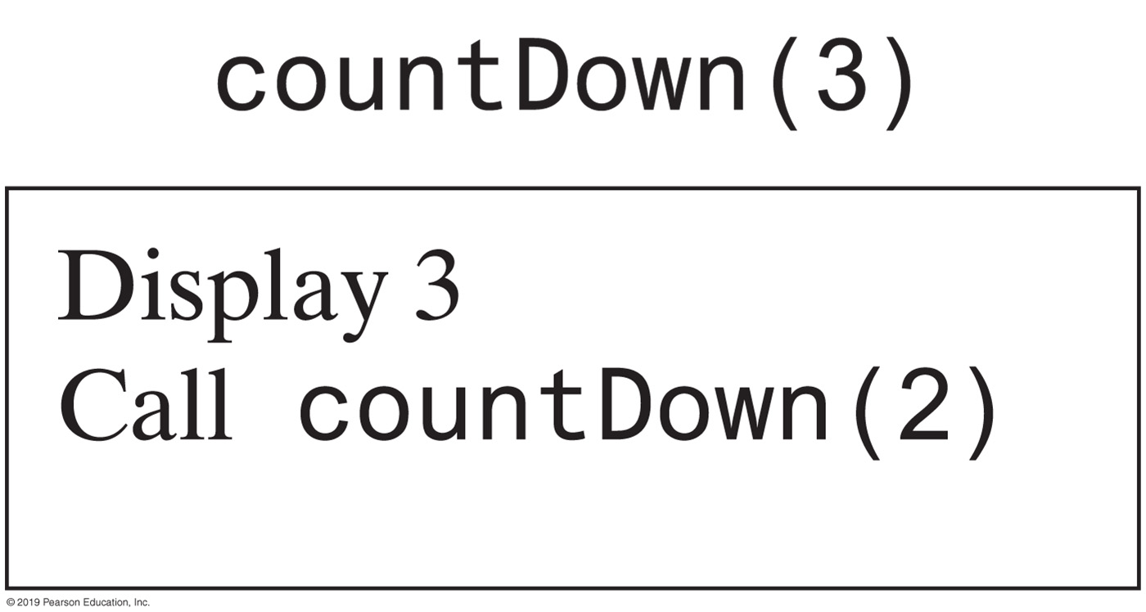
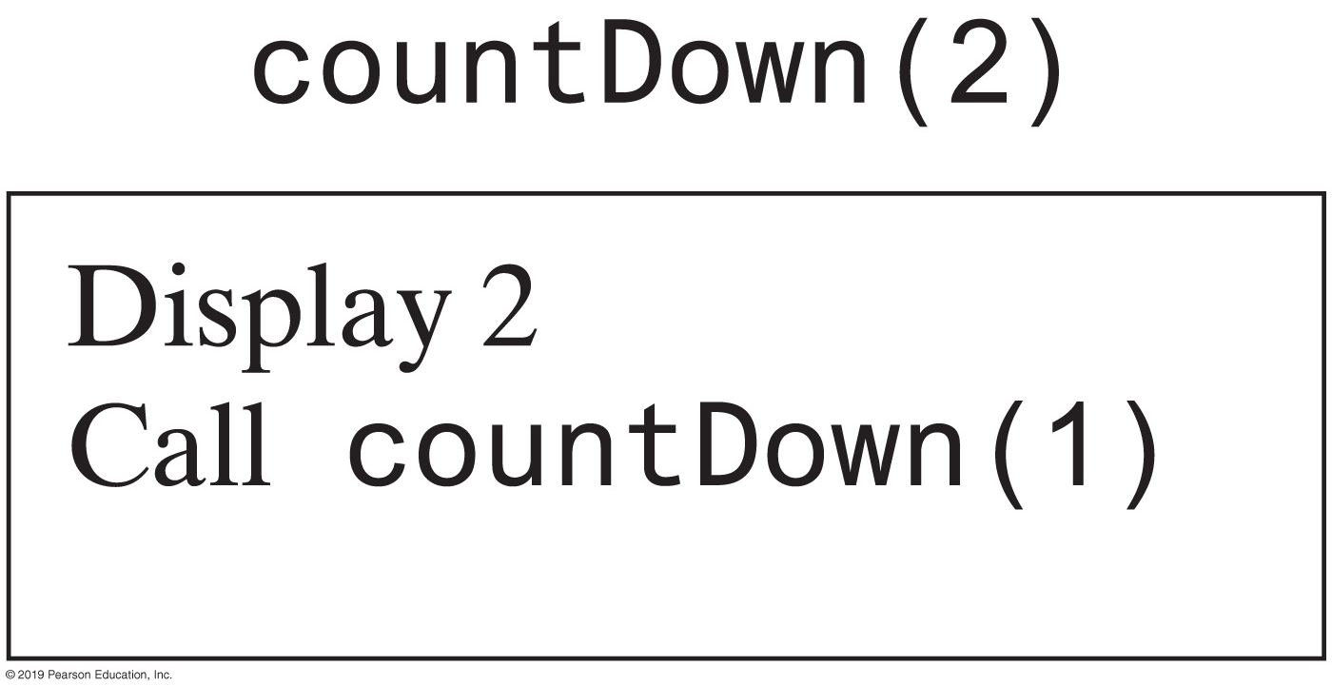
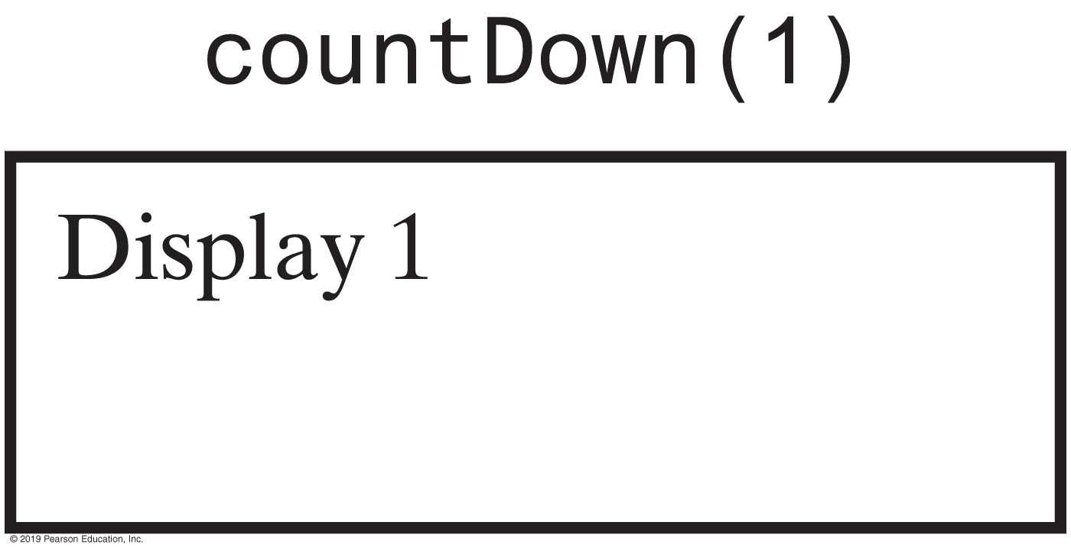
Recursive Method
The effect of the method call countDown(3)

Slide 5
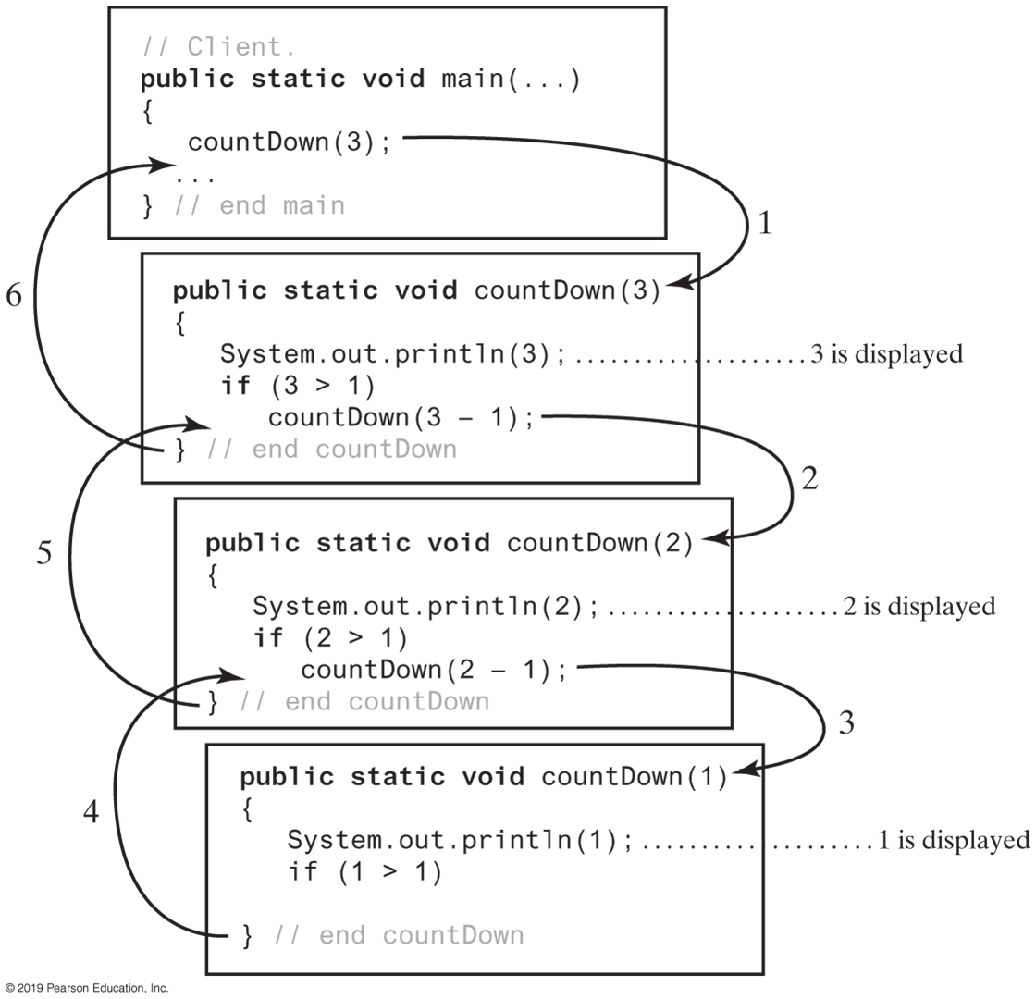
Tracing a Recursive Method
Notes:
Review video notes
Why are we doing this?

Slide 6
Activity | The Countdown
/** Counts down from a given positive integer.
@param integer An integer > 0.
*/
public static void countDown(int i)
{
System.out.println(i);
if (i > 1)
countDown(i - 1);
} // end countDown
Recursive Java method to do countDown
Notes:
coutDown() calls itself (repeatedly)
Write your code

Slide 7
What’s Recursion?
Recursion is a problem-solving technique
Breaks a problem into identical but smaller problems
A method that calls itself is a recursive method
The invocation is a recursive call or recursive invocation
Direct vs. Indirect recursions

Slide 8
Real World Example
Consider hiring a contractor to build (a home)
He hires a subcontractor for a portion of the job
That subcontractor hires a sub-subcontractor to do a smaller portion of job
The last sub-sub- … subcontractor finishes
Each one finishes and reports “done” up the line

Slide 9
Factorial | 4!
4!
24
return (4 * 3!)
6
return (3 * 2!)
2
return (2 * 1!)
1
return (1 * 0!)
1
0!

Slide 10
Factorial | Example
Original problem n!
Reduced problem: (n-1)!
Original problem: n! = n * reduced problem
General solution: n * (n-1)!
10

Slide 11
Reduced Problem for n!
The reduced problem should be:
Similar to the original problem
Something factorial
A small step away from the original problem in the direction of the base case
(n-1)! or (n-2)! or (n-3!) or ….
That reduces to the base case when repeatedly reduced
Only (n-1)! will degenerate in to 0! for all n
Therefore (n-1) is chosen as the reduced problem
Base Case is 0!
11

Slide 12
Recursive Algorithm for n!
public static long nFactorial(long n)
{
long nMinus1Factorial;
if(n == 0) // base case
return ( 1 );
else
{ // reduced problem
nMinus1Factorial = nFactorial(n-1); // recursion
// general solution
return ( n * nMinus1Factorial);
}
}

Slide 13
Approach
Four steps to formulate recursive algorithms
Determine the base case
Determine the reduced problem
Determine the general solution
Combine the base case, reduced problem and general solution to form the recursive algorithm
Methodology is directly applicable to many problems with recursive solutions
13

Slide 14
Base Case | Determining
Identify an instance of the problem whose solution is known. Could be an instance when
The solution is defined, or
The instance is a special case, or
There is a trivial solution
Often occurs when n ==0 or n ==1
Examples
0! ≡ 1
A string of length 1
An empty list
A found search item
14

Slide 15
Reduced Problem
Requires forward thinking and creativity
Look for a problem
Similar to the original problem
A small step away from the original problem, in the direction of the base case
Reduces to the base case when repeatedly doing so
Should be in between the original problem and the base case
15

Slide 16
General Solution
Consider how the reduced problem can be used to
Solve the original problem
16

Slide 17
Design Guidelines
Method must be given an input value
Method definition must contain logic that involves this input, leads to different cases
One or more cases should provide solution that does not require recursion
Otherwise, you are looking at infinite recursion
One or more cases must include a recursive invocation

Slide 18
Fibonacci Numbers
F0 = 1
F1 = 1
Fn = Fn - 1 + Fn - 2 when n ≥ 2
Algorithm Fibonacci(n)
if (n <= 1)
return 1
else
return Fibonacci(n − 1) + Fibonacci(n − 2)
Notes:
What if n <= 0?

Slide 19
Fibonacci | Recursive Algorithm
Base case
A defined solution for n = 0 and n = 1.
F1 ≡ 1, F2 ≡ 1
Reduced Problem
Fn-1 and Fn-2 are close to original problem, and will become one of the base cases when further reduced
General solution (by definition)
Fn ≡ Sum of reduced problems = Fn-1 + Fn-2
Combine
19

Slide 20
Activity | Fibonacci Sequence
public static long fibonacci(int n)
// implement your logic here
}
20
Notes:
Solution available next slide

Slide 21
Solution | Fibonacci Sequence
public static long fibonacci(int n)
{ if(n == 1 || n == 2) //one of the 2 base cases
return 1;
else
{ long rp1 = fibonacci(n - 1); // first reduced problem
long rp2 = fibonacci(n - 2); // second reduced problem
gs = rp1 + rp2; // general solution
return gs;
}
}
We can do better. Why is this inefficient?
21
Notes:
It’s inefficient because …
Try to write non recursive code

Slide 22
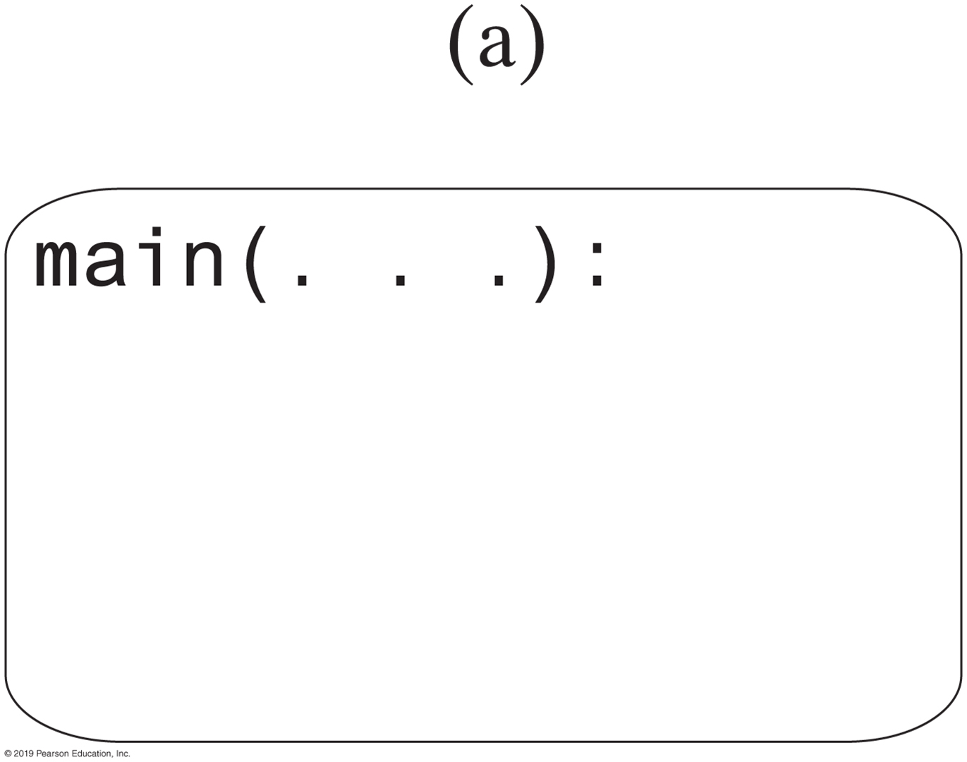
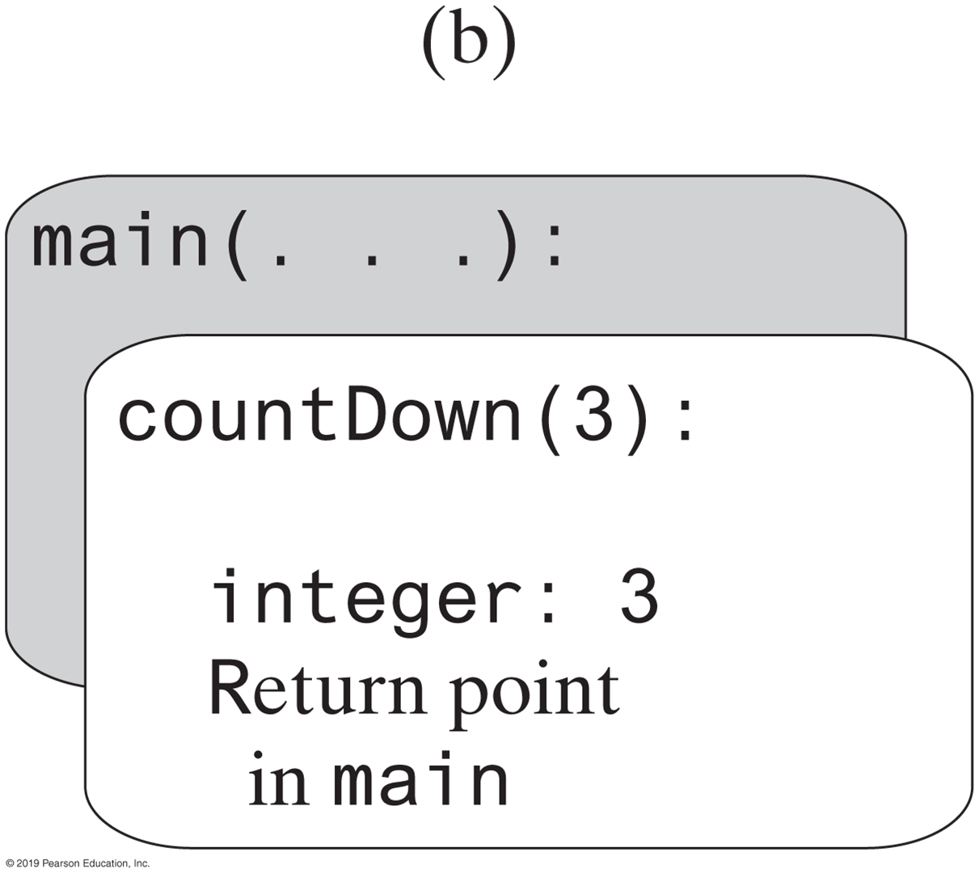
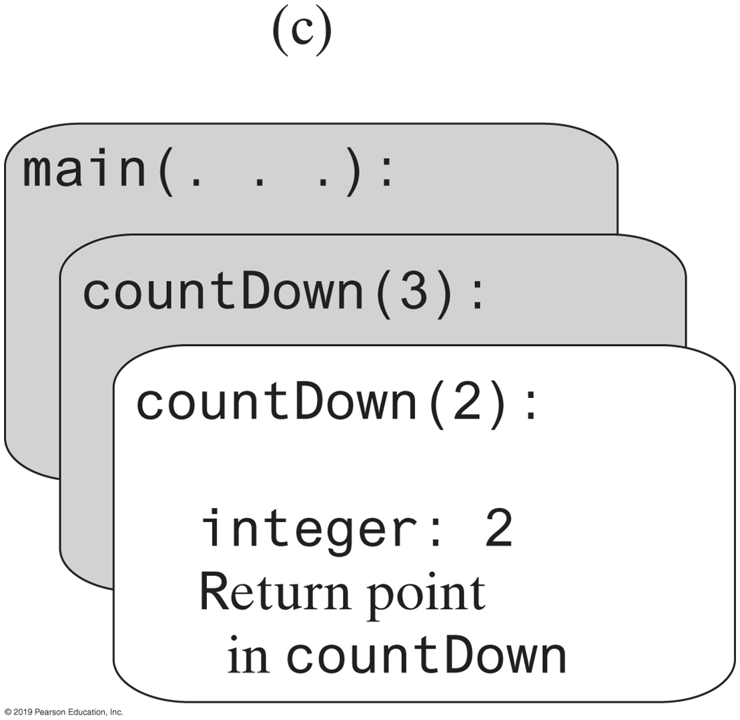
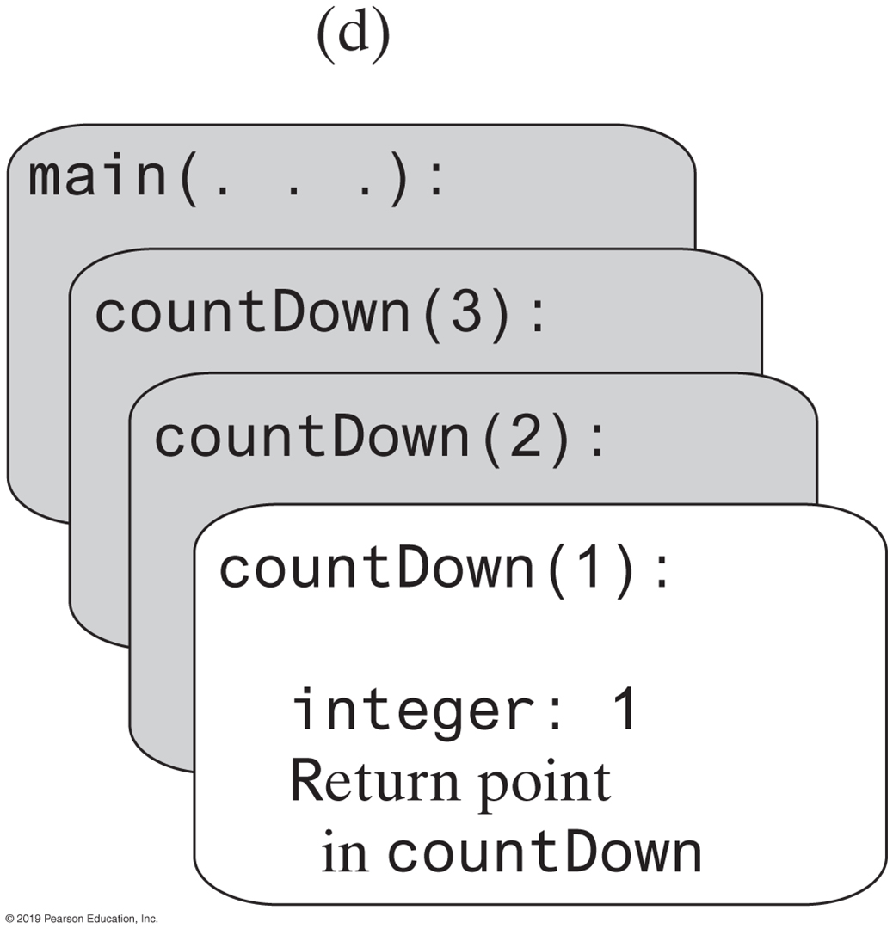

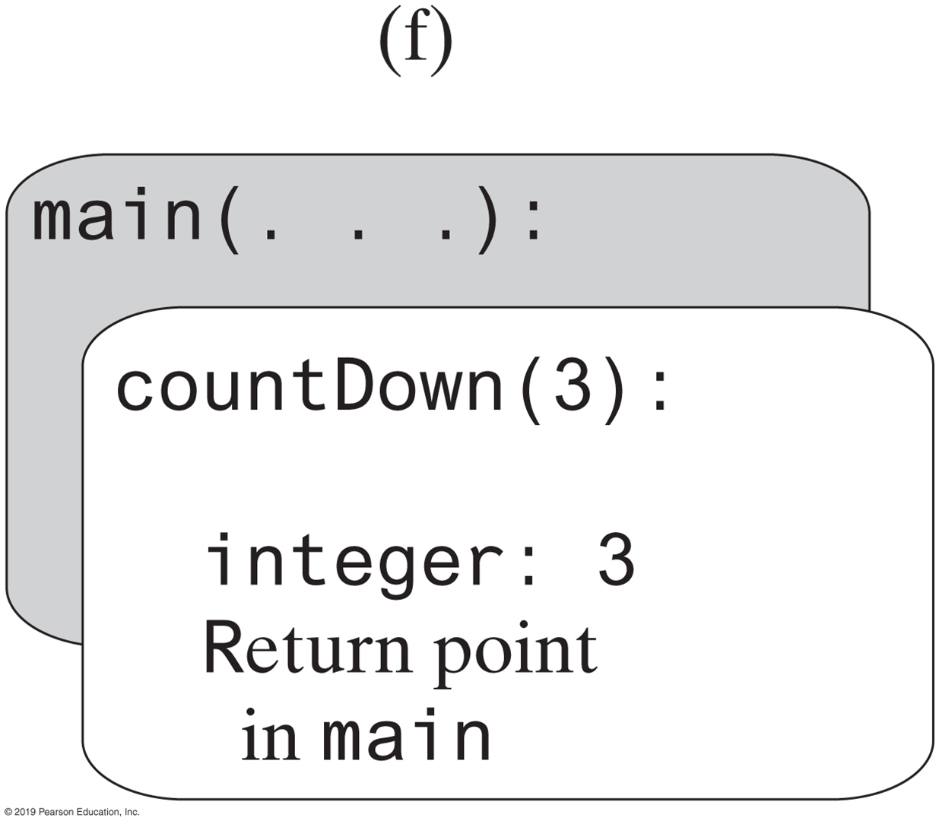
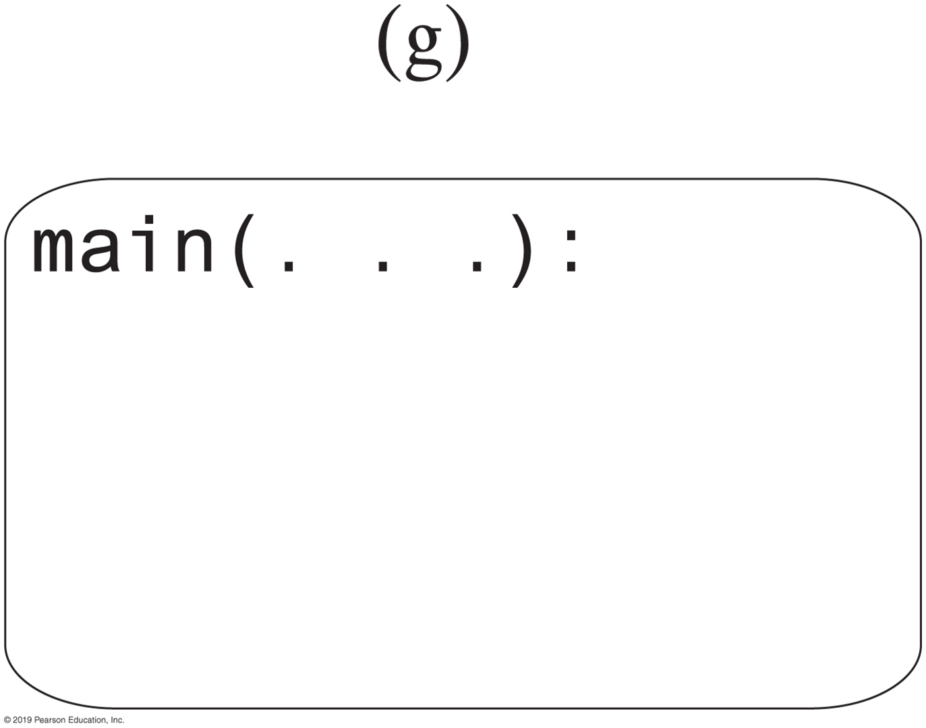
Stack of Activation Records (1 of 2)
https://www.geeksforgeeks.org/stack-vs-heap-memory-allocation/
Notes:
What should you be concerned with?

Slide 23
Stack of Activation Records (2 of 2)
Each call to a method generates an activation record
Recursive method uses more memory than an iterative method
Each recursive call generates an activation record
If recursive call generates too many activation records, could cause stack overflow

Slide 24

Activity | Implement Recursive Routine
/** @param n An integer > 0.
@return The sum 1 + 2 + ... + n. */
public static int sumOf(int n)
{
// Your logic
} // end sumOf
Recursive Method that Returns a Value (Running total)
Notes:
Iterative version
Recursive version
What is the base case?
What is the reduced case?
General case?

Slide 25
Activity | Solution
/** @param n An integer > 0.
@return The sum 1 + 2 + ... + n. */
public static int sumOf(int n)
{
int sum;
if (n == 1)
sum = 1; // Base case
else
sum = sumOf(n - 1) + n; // Recursive call
return sum;
} // end sumOf
Recursive Method that Returns a Value (Running total)
Notes:
What is the base case?
What is the reduced case?
General case?

Slide 26
Displaying a Bag
public void display()
{
displayArray(0, numberOfEntries - 1);
} // end display
private void displayArray(int first, int last)
{
System.out.println(bag[first]);
if (first < last)
displayArray(first + 1, last);
} // end displayArray
Recursive method that is part of an implementation of an ADT often is private

Slide 27
Activity
Output a string of length n in reverse order
Example
String s = “sara”;
→ aras
Implement it as an iterative method
Implement it again as a recursive method instead
public static void stringReverse(String s, int n)
Notes:
?? What if this is a linked list?

Slide 28
Activity | Solution
public static void stringReverse(String s, int n)
{
if(n == 0) // base case
return;
else // general solution
{
// output last character
System.out.print(s.charAt(n-1));
stringReverse(s, n-1); // reduced problem (recursion)
}
}
28
Notes:
Complete this and next activities during class

Slide 29
String Reverse | Hidden Base Case
// This can be rewritten with a hidden base case
public static void stringReverse(String s, int n)
{ if(n > 0) // general case
{
System.out.print(s.charAt(n-1)); // output last character
stringReverse(s, n-1); // reduced problem (recursion)
}
}

Slide 30
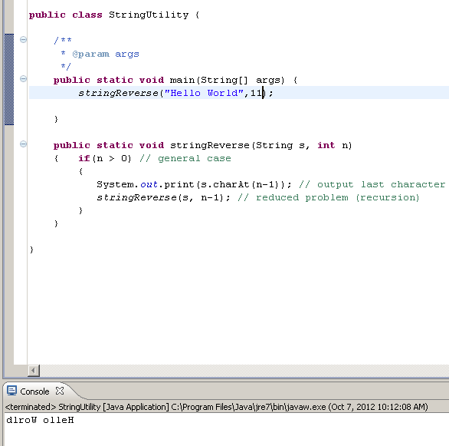

Slide 31
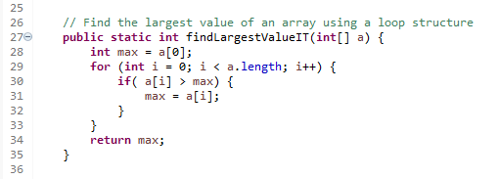
Finding Array’s Largest Value (Iteratively)

Slide 32

Array’s Largest Value | Recursion
To find the largest element in list[a] … list[b]
Find the largest element in list[a+1] … list[b] and call is max
Compare the element in list[a] and max return the larger of the two
Compare to
this element
Find max in this group
Return the largest

Slide 33
Array’s Largest Value | Recursion
If the size of the list is 1 – the only element in the list is the largest element
Compare with this element
and return max
a. Find max in this group
b. Find max in this group
c. Find max in this group
Compare with this element
and return max
d. Find max in this group
Compare with this element
and return max
e. Find max in this group
(it is 4)
Compare with this element
and return max
Compare with this element
and return max
Notes:
Don’t look ahead; solution available next page
public static int largestValue(int[] a) { … }

Slide 34
Activity | Recursion Approach
A[10]
B[10, 5]
C[10, 5, 81]
C[10, 5, 81, 9]
Activity – Implement your recursive routine next
public static int largestValue(int[] a, int lower, int upper)
{
// your logic
}
Notes:
Don’t look; solution available next slide

Slide 35
Array’s Largest Value | Solution
public static int largest(int list[], int lowerIndex, int upperIndex)
{
int max;
if(lowerIndex == upperIndex) //the size of the sublist is 1
return list[lowerIndex];
else
{
max = largest(list, lowerIndex + 1, upperIndex);
if(list[lowerIndex] >= max)
return list[lowerIndex];
else
return max;
}
}

Slide 36
Processing an Array | Front to Back
public static void displayArray(int array[], int first, int last)
{
System.out.print(array[first] + " ");
if (first < last)
displayArray(array, first + 1, last);
} // end displayArray
How do we process an array, going from back to front instead?
Starting with array[first]
Notes:
Don’t look; solution on next page

Slide 37
Processing an Array | Back to Front
public static void displayArray(int array[], int first, int last)
{
if (first <= last)
{
displayArray(array, first, last - 1);
System.out.print(array[last] + " ");
} // end if
} // end displayArray
Starting with array[last]

Slide 38
Recursively Processing a Linked Chain
public void display()
{
displayChain(firstNode);
} // end display
private void displayChain(Node nodeOne)
{
if (nodeOne != null)
{
System.out.println(nodeOne.getData()); // Display data in first node
displayChain(nodeOne.getNextNode()); // Display rest of chain
} // end if
} // end displayChain
Display data in first node and recursively display data in rest of chain

Slide 39
Recursively Processing a Linked Chain
public void displayBackward()
{
displayChainBackward(firstNode);
} // end displayBackward
private void displayChainBackward(Node nodeOne)
{
if (nodeOne != null)
{
displayChainBackward(nodeOne.getNextNode());
System.out.println(nodeOne.getData());
} // end if
} // end displayChainBackward
Displaying a chain backwards. Traversing chain of linked nodes in reverse order easier when done recursively

Slide 40
Using Stack Instead of Recursion Reverse Print Linked List
current = first;
while(current != NULL)
{
stack.push(current);
current = current.link;
}
while (!stack.isEmpty( ))
{
System.out.println(stack.top());
stack.pop();
}
Trace through code and show how it prints in reverse?

Slide 41
Tail Recursion
When the last action performed by a recursive method is a recursive call
This call performs a repetition that can be done by using iteration
Converting a tail-recursive method to an iterative one is usually a straightforward process
public static void countDown(int n)
{
System.out.println(n);
if (n > 1)
countDown(n - 1);
} // end countDown

Slide 42
Tail Recursion
Converting a recursive method to an iterative one
public static void countDown(int i)
{
if (i >= 1)
{
System.out.println(i);
countDown(i - 1);
} // end if
} // end countDown
An iterative version
public static void countDown(int i)
{
while (i >= 1)
{
System.out.println(i);
i = i − 1;
} // end while
} // end countDown

Slide 43
Programming Tip
Iterative method contains a loop
Recursive method calls itself
Some recursive methods contain a loop and call themselves

Slide 44
Fibonacci Numbers | 2nd Look
F0 = 1
F1 = 1
Fn = Fn - 1 + Fn - 2 when n ≥ 2
Algorithm Fibonacci(n)
if (n <= 1)
return 1
else
return Fibonacci(n − 1) + Fibonacci(n − 2)
Notes:
What if n <= 0?

Slide 45
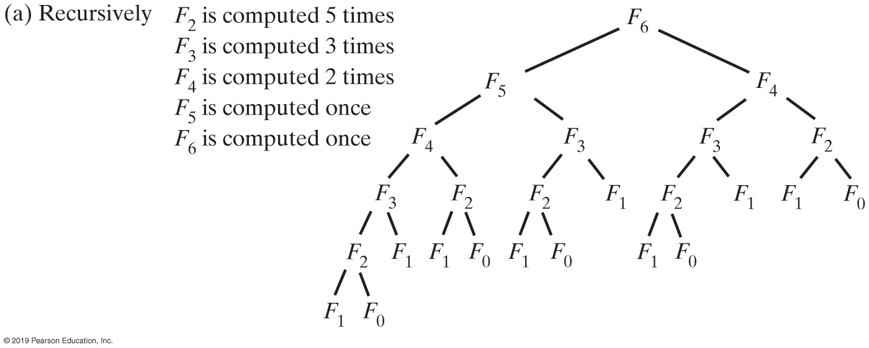
Simple Problem | Poor Solution
The computation of the Fibonacci number F6
Notes:
An idea recursive algorithm, but a very inefficient implementation

Slide 46
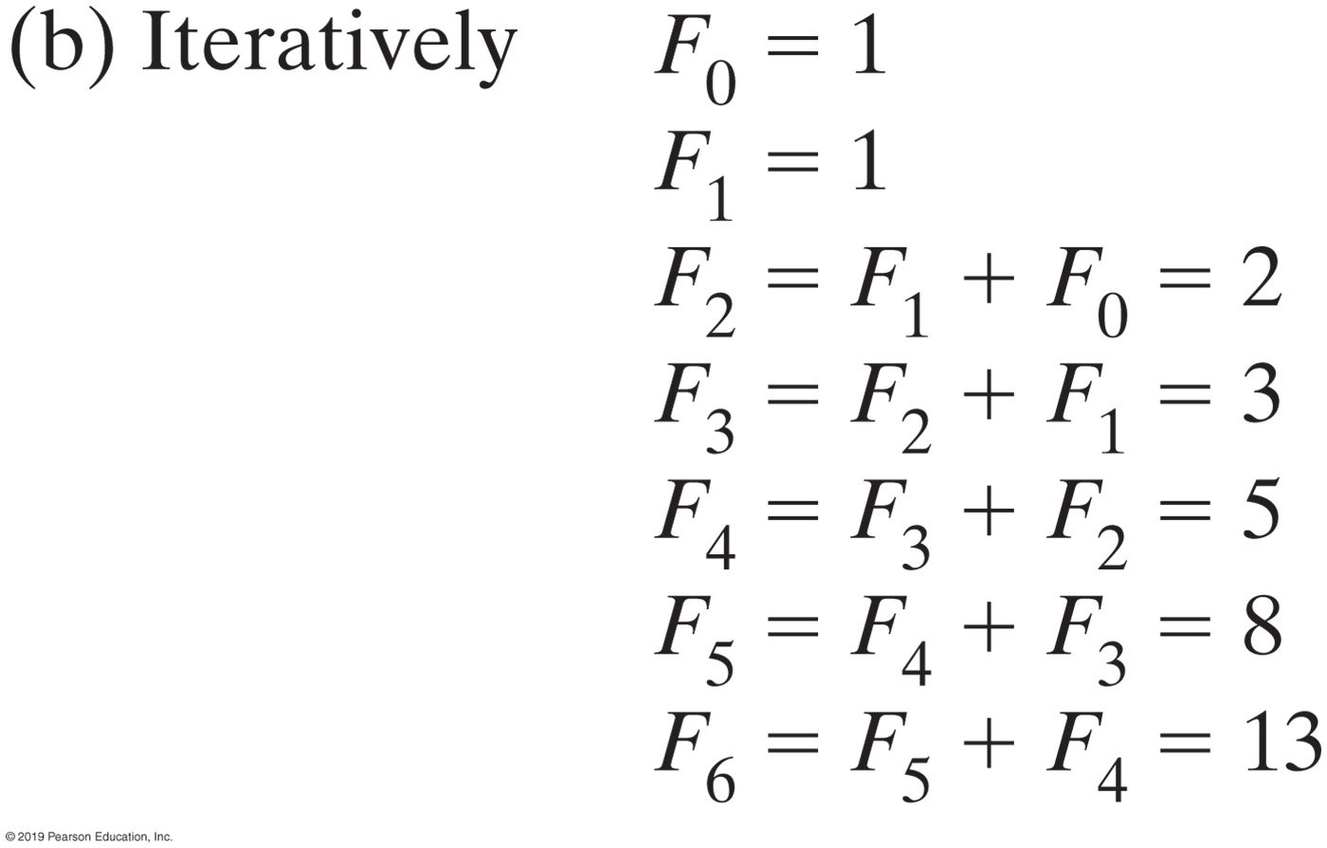
Simple Problem | Poor Solution
The computation of the Fibonacci number F6
Notes:
Iteratively is better than recursively for this case

Slide 47
Dynamic Programming
Look for parts of the algorithm that repeatedly calculate the same value
First time a value is calculated, store it in a table
Next time the value is to be calculate, look it up in the table
This eliminates computation time for all but the first calculation
47

Slide 48
Dynamic Programming Applied to Recursive Algorithms
Before a recursive invocation, check table
If problem solution is in the table, return it
If reduced problem is in the table use it
Otherwise
Make recursive invocation
Write reduced problem solution into the table
Calculate general solution, write it into table & then return it
48

Slide 49
Activity | Dynamic Programming Applied to Method factorial
The Array value
1. if (n == 0) return 1;
2. If (value[n] != 0) return value[n];
3. If (value[n-1] != 0)
4. { value[n] = n * value[n-1]
return value[n]
} // end of base cases
7. else // use recursion
8. { value[n-1] = factorial(n-1));
value[n] = n * value[n-1];
return value[n] }
index
index
index
0
0
0
1
0
0
1
0
1
1
1
1
2
0
2
2
2
2
3
0
3
6
3
6
4
0
4
24
4
24
5
0
5
0
5
120
6
0
6
0
6
0
7
0
7
0
7
0
8
0
8
0
8
0
:
:
:
:
:
:
Intialized State
After 4! Is Calculated
After 5! Is Calculated
Subsequent calculation of 1, 2, 3, 4, 5, or 6 factorial do not require recursive invocations
49
Notes:
This is your HW assignment
Think about doing the same thing for Fibonacci number

Slide 50
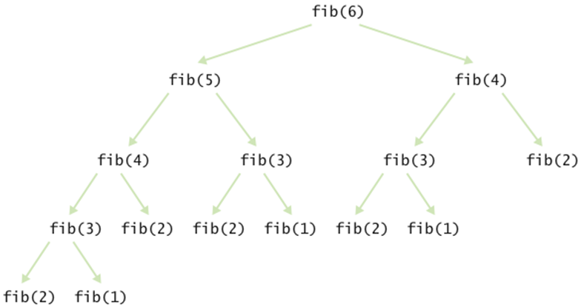
Fibonacci Number (Dynamic Programming)
The Array value
Fn = Fn-1 + Fn-2
index
index
index
0
0
0
0
0
0
1
0
1
1
1
1
2
0
2
1
2
1
3
0
3
2
3
2
4
0
4
3
4
3
5
0
5
0
5
5
6
0
6
0
6
8
7
0
7
0
7
0
8
0
8
0
8
0
:
:
:
:
:
:
Intialized State
After Fib(4) Is Calculated
Subsequent calculation of 1, 2, 3, 4, 5, or 6 do not require recursive invocations

Slide 51
Indirect Recursion
Example
Method A calls Method B
Method B calls Method C
Method C calls Method A
Difficult to understand and trace
But does happen occasionally

Slide 52
Indirect Recursion | Example
Consider evaluation of validity of an algebraic expression
Algebraic expression is either a term or two terms separated by a + or – operator
Term is either a factor or two factors separated by a * or / operator
Factor is either a variable or an algebraic expression enclosed in parentheses
Variable is a single letter
Notes:
Processing an infix algebraic expression

Slide 53
No Loop Programming Languages
Functional programming languages (e.g. Haskell, Erlang) generally don't have loops
Nor do function-level languages (e.g. FP, J) or logic languages (e.g. Prolog, Planner)
Indeed pretty much the entire group of declarative languages (of which functional, function-level, logic, etc.)

Slide 54
Practical Problem Solutions
Problem | Base Case | Reduced Problem | General Solution
Calculate the sum of the integers from n to 1, S_{n} | n = 1, S_{n} = 1, | S_{n-1}, the sum of the integers from (n-1) to 1 | S_{n} = n + S_{n-1}
Calculate the product of two integers, p = m*n | n = 0, p = 0 n=1, p = m | m*(n-1) | p = m + m*(n-1)
Calculate the n^{th} term of the Fibonacci sequence, f_{n} | f₁ = 1, f₂ = 1 | f_{n-1,} f_{n-2} | f_{n} = f_{n-1} + f_{n-2}
Binary search of an array to find X | if array size = 0 X not present. if middle array element = X return middle element’s index. | Binary Search a sub-array | if middle element > X, make the sub- array the upper half of the array, else make it lower half of the array. Binary search the sub-array
traversing a binary tree (in LNR order) | if no subtree, don’t traverse it | traverse a sub tree | Traverse the root’s left subtree; Visit the root node; Traverse the root’s right subtree.
Calculate the greatest common denominator of two integers m and n (m>n), GCD(n,m) | n = 1, GCD(m,n) = 1 n = 0, GCD(m,n) is m | GCD(n, m%n) | GCD(n,m) = GCD (n, m%n)
Merge Sort (described in Chapter 8) | If 1 item to be sorted, do nothing | Merge Sort the upper or lower half of the list | Merge Sort lower half of list; Merge sort lower half of list; Combine the sorted lower and upper halves of the lists;
Quick Sort (described in Chapter 8) | If 1 item to be sorted, do nothing | Quick Sort any area of a list | Partition the list; Move items into their correct partition; Quick Sort the left partition; Quick Sort the right partition;
54

Slide 55
Select Recursive Applications
Queens Eight
Place eight queens on a checkerboard such that they cannot capture each other
Numeric Puzzle (Sudoku)
Towers of Hanoi
Q
Q
Q
Q
Q
Q
Q
Q
5 | 8 | 2 | 1 | 3 | 4 | 9 | 7 | 6
3 | 4 | 9 | 5 | 6 | 7 | 1 | 2 | 8
7 | 6 | 1 | 9 | 2 | 8 | 4 | 3 | 5
8 | 2 | 3 | 4 | 9 | 1 | 5 | 6 | 7
4 | 7 | 5 | 3 | 8 | 6 | 2 | 9 | 1
1 | 9 | 6 | 7 | 5 | 2 | 3 | 8 | 4
2 | 5 | 8 | 6 | 1 | 9 | 7 | 4 | 3
9 | 3 | 7 | 8 | 4 | 5 | 6 | 1 | 2
6 | 1 | 4 | 2 | 7 | 3 | 8 | 5 | 9
55
Notes:
Can you solve these problems without using recursion?

Slide 56
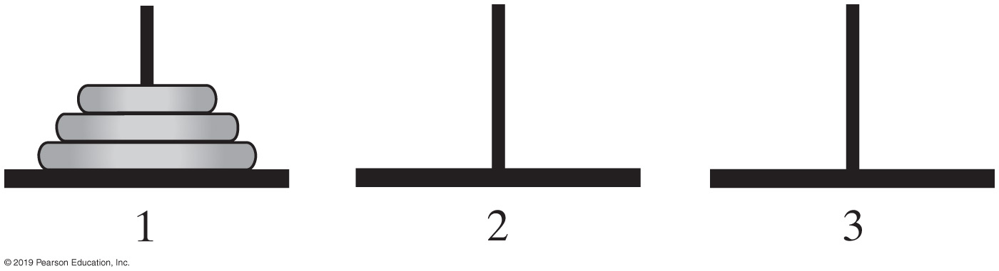
Towers of Hanoi
Simulations
http://towersofhanoi.info/Animate.aspx
https://hanoi.aimary.com/index_en.php
The initial configuration of the Towers of Hanoi for three disks

Slide 57
Towers of Hanoi | Difficult Problem
Rules:
Move one disk at a time. Each disk moved must be the topmost disk
No disk may rest on top of a disk smaller than itself
You can store disks on the second (extra) pole temporarily, as long as you observe the previous two rules
How do you solve this problem, iterative vs. recursive routines?
Relatively simple recursive solution to a difficult problem

Slide 58
Towers of Hanoi | Recursive Solution
Base case
A trivial solution (n = 1): move 1 ring from one tower to another
Reduced problem
Candidates are move n-1, or n-2, or n-3, … rings from one tower to another
Move n-1 rings is the only one that will become the base case for all n
General solution
Move n-1 rings from S to E (Source to Extra tower)
Move 1 ring from S to D (Source to Destination tower)
Move n-1 rings from E to D (Extra to Destination tower)
Combine
58

Slide 59
Algorithm
Algorithm to move numberOfDisks disks from startPole to endPole using tempPole
as a spare according to the rules of the Towers of Hanoi problem
if (numberOfDisks == 1)
Move disk from startPole to endPole
else
{
Move all but the bottom disk from startPole to tempPole
Move disk from startPole to endPole
Move all disks from tempPole to endPole
}
Recursive algorithm to solve any number of disks. For n disks, solution will be 2^{n} – 1 moves

Slide 60
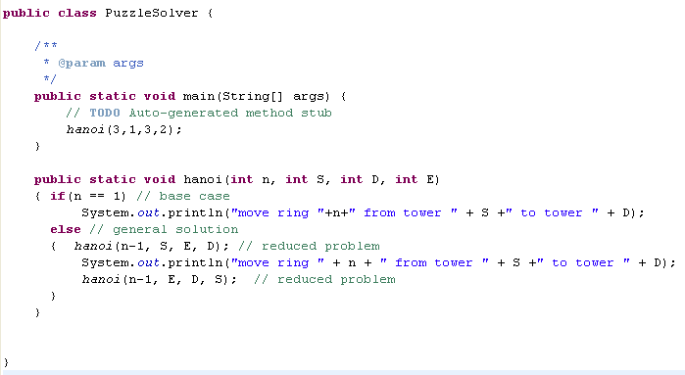
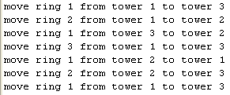

Slide 61
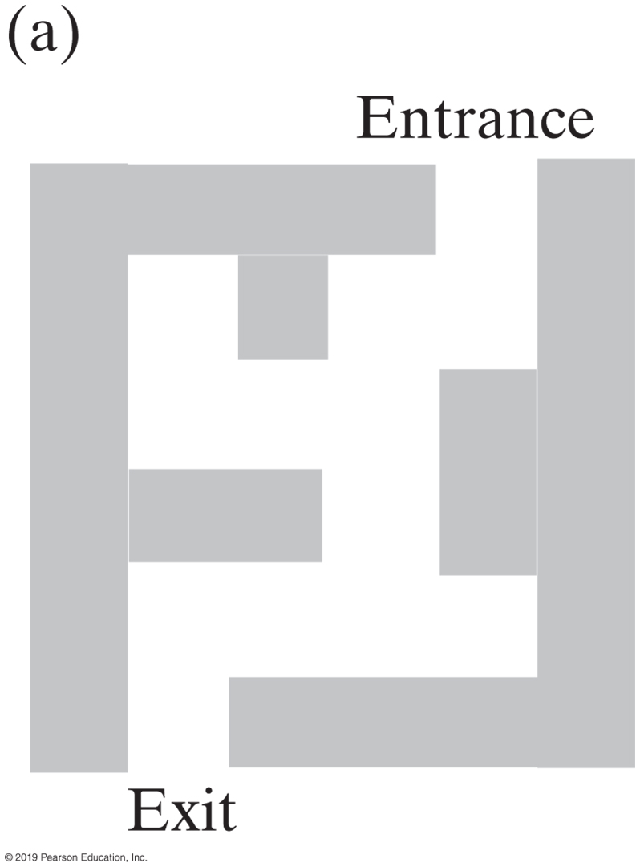
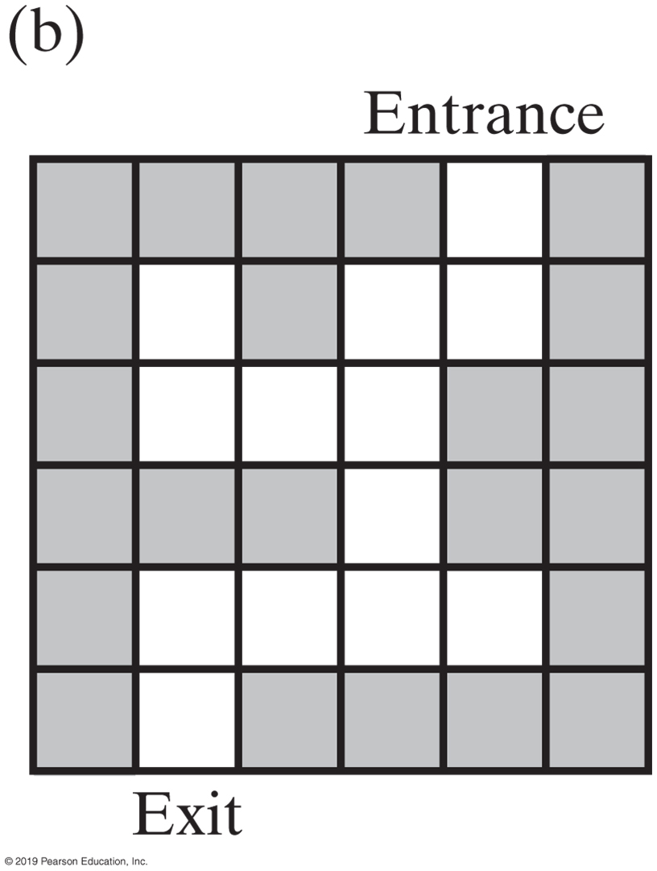
Backtracking
A two-dimensional maze with one entrance and one exit
Notes:
Maze challenge – start from Entrance and finish at Exit
How do you write code to solve this problem?

Slide 62
Backtracking
Use to solve a class of problems –
Given a starting point determine a sequence of correct choices, selected from a finite set of choices, to reach a goal
An entry point into a maze, reach the exit point
Many numeric puzzles such as Sudoku
Given a Queen’s position, place 7 more Queens safely on a checkerboard
Given a Knight’s position, move it so that all squares are visited only once
Can be generalized & a methodized approach
Can be followed to adapt it to a particular problem
Technique involves navigating a decision tree to arrive at the goal
62
Notes:
Decision tree

Slide 63
Maze Example Enter Maze at X(0,1); Goal is to reach 1,2
 | 0 | 1 | 2
2
1 |  |  | Goal
0 |  | X
Specify choice order: straight ahead, left turn, right turn
63
Notes:
Dark lines are walls
How do we get from X to Goal?
How do we write a program to get from any (location of) X to any (final destination) Goal?

Slide 64
Maze Example Enter Maze at 0,1; Goal is to reach 1,2
Using the decision tree depicted below the maze, it would be traversed in 13 moves:
[0,1], [1,1], [2,1], [2,0], backtrack to [2,1], backtrack to [1,1], [1,0], backtrack to [1,1], backtrack to [0,1], [0,0], backtrack to [0,1], [0,2], [1,2] (at the goal)
Why 13 moves?
 | 0 | 1 | 2
2 | 4 | 3/5
1 | 7 | 2/6/8 | Goal 13
0 | 10 | 1/9/11 | 12
0,1
1,1
0,0
0,2
2,1
1,0
1,2
goal
2,0
2,2
Decision Tree
Choice order is: straight ahead, left turn, right turn
64
Notes:
We need an algorithm which will get us to our final destination (it can be anywhere on the board)

Slide 65
Decision Trees
Depict choices available at decision points
A circle represents a decision point
Circles immediately below a decision point are the choices available at that decision point
Upper most circle is the starting point
S
Decision point 0, the starting point
A
B
Choices at S
Choices at A
C
D
E
F
G
Choices at B
H
Choice at F
65

Slide 66
Navigating a Decision Tree
From S Reach H
Assume decisions (choices) are made from left to right
When we make a choice we record it
When we are not at the goal and the choices are exhausted, we backtrack and un-record the choice
Path: S to A, to C, backtrack to A, to D, backtrack to A, to E, backtrack to A, backtrack to S, to B, to F, to H (goal)
S
A
B
C
D
E
F
G
H
goal
66

Slide 67
Generalized Backtracking Algorithm boolean makeNextDecision(lastDecisionChoice)
atGoal = false;
choiceNumber =0; // initialize the choice number for this decision point
while(atGoal == false && choiceNumber < numberOfChoices) // more choices
{ thisDecisionChoice = nextChoice(choiceNumber, lastDecisionChoice);
if( // thisDecisionChoice is valid )
{ // record thisDecisionChoice
if( // goal has been reached ) // base case
return true; // reached the goal
else
{ atGoal = makeNextDecision(thisDecisionChoice); // reduce problem
if(atGoal == false) // backtrack has occurred
{ // un-record thisDecisionChoice
} // end if
} // end else
} // end if
choiceNumber = choiceNumber + 1;
} return atGoal; // end while
Red text is problem specific

Slide 68
Adapting Generalized Backtracking Algorithm to a Particular Problem
1- Decide how to represent the n choices available at each decision point
Decide how to, and then code methods to:
2. Determine if the goal has been reached (line 7)
3. Record and un-record a choice (lines 6 & 12)
4. Determine the next choice (line 4)
5. Determine if a choice is valid (line 5)
6. Code the generalized algorithm invoking methods of steps 2-5
7. Code the application that invokes the backtracking method
68

Slide 69
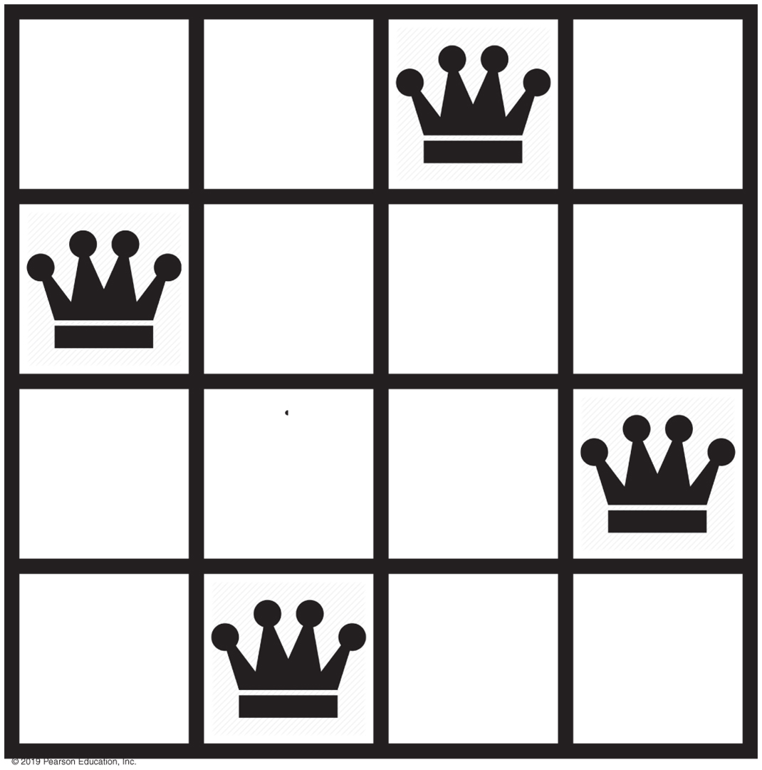
4-Queens | Example

Slide 70
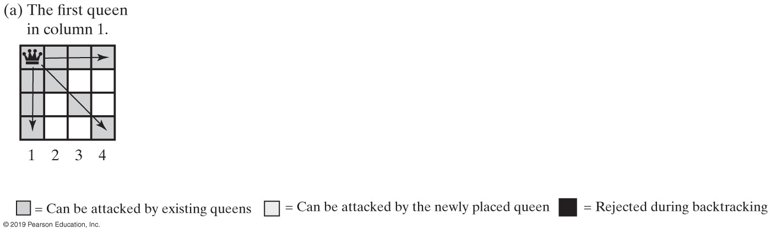
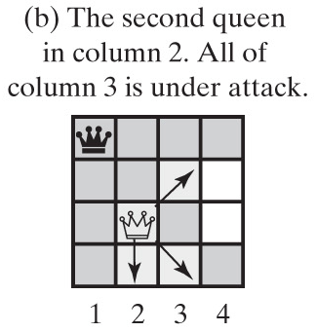
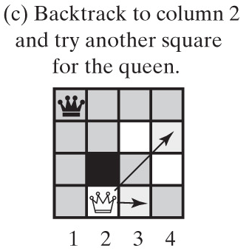
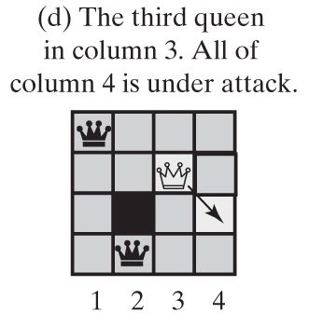
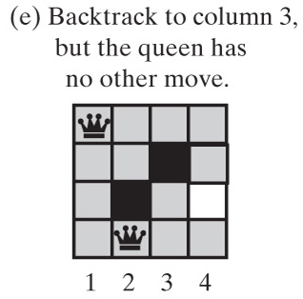
Backtracking - Queens Solution (1 of 1)
Solving the four-queens problem by placing one queen at a time in each column

Slide 71
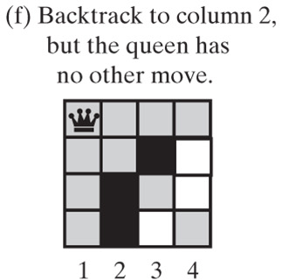
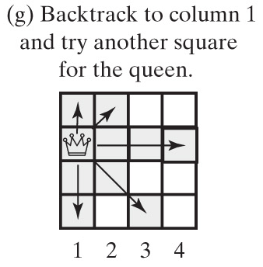
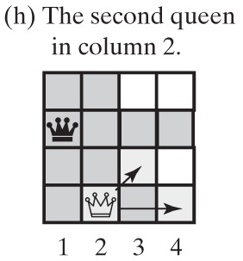
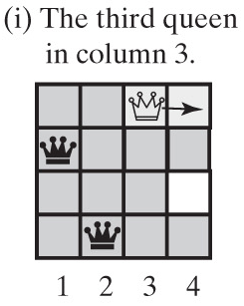
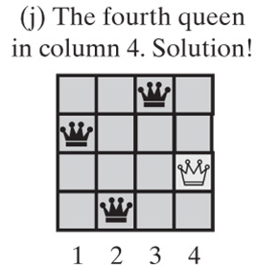
Backtracking - Queens Solution (2 of 2)
Solving the four-queens problem by placing one queen at a time in each column

Slide 72
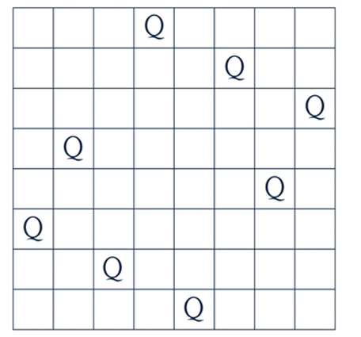
Solution to 8-Queens Puzzle
https://www.geeksforgeeks.org/n-queen-problem-backtracking-3/
https://www.geeksforgeeks.org/java-program-for-n-queen-problem-backtracking-3/

